Slide 1

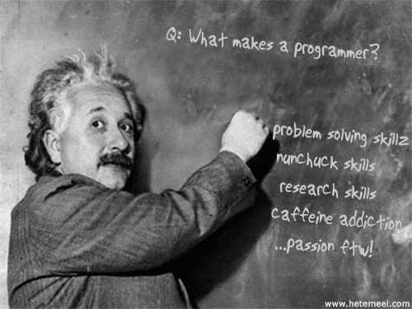


ASP.NET MVC Advanced Topics
Authentication, Security, Configuration, Performance, Best Practices
Nikolay Kostov
Team Lead, Senior Developer and Trainer
http://Nikolay.IT
Telerik Software Academy
academy.telerik.com

Slide 2

Table of Contents
Authentication and Authorization
Security (CSRF and XSS)
SimpleMembership
Performance and Caching
Localization and Resources
Diagnostics and Health Monitoring
Unit Testing
Deployment and Configuration

Slide 3
TODO
Good Practices
What is in the next version (ASP.NET MVC 5)
Async?

Slide 4
Mocking
TODO
public void IndexActionShouldReturnProperModel()
{
var list = new List<Bug> { new Bug() };
var bugsRepoMock = new Mock<IRepository<Bug>>();
bugsRepoMock.Setup(x => x.All()).Returns(list.AsQueryable());
var uowMock = new Mock<IUowData>();
uowMock.Setup(x => x.Bugs).Returns(bugsRepoMock.Object);
var controller = new HomeController(uowMock.Object);
var actionResult = controller.Index() as ViewResult;
Assert.IsNotNull(actionResult);
var model = actionResult.Model as IEnumerable<Bug>;
Assert.IsNotNull(model);
Assert.AreEqual(1, model.Count());
}

Slide 5
ASP.NET Pipeline
Request
BeginRequest
-Look for incoming credential
-Authenticate credential
-Set Principal
AuthenticateRequest
PostAuthenticateRequest
-Add claims / roles to principal
AuthorizeRequest
-Determine if user is allowed to access resource
…
ExecuteHandler
Resource Rendering
…
Response
EndRequest

Slide 6

Authentication
What is Authentication?

Slide 7
Authentication
Why we verify the identity of a user?
Bank account
Picture collection
Shows information specific to a user and track information that we want.
The authentication type is set in the configuration file
User.Identity

Slide 8
Different Types of Authentication
Windows Authentication
Forms Authentication
OpenID / Oauth
Authentication

Slide 9
Windows authentication
Typically used for Intranet Applications
Uses components and services from the OS
“Integrated authentication” – single sign on through Active Directory server
Works on variety of browsers
It is not recommended for Internet applications
Users from different domains
Users using different operating systems

Slide 10

Forms Authentication
GET -> POST -> Redirect
Get a login or registration form
POST back the input to a controller action
If credentials are correct, redirect to another controller action (members area)
Cookies – (.ASPXAUTH=…)
Session – (.ASP.NET_SessionId=…)
Secure socket layer - SSL

Slide 11
Forms Authentication
Return the login form via GET request
By default every Action method in ASP.NET MVC will handle requests via GET
Restricts action method so that it handles only HTTP GET requests
[HttpGet]
[AllowAnonymous]
public ActionResult Login(string returnUrl)
{
ViewBag.ReturnUrl = returnUrl;
return View();
}

Slide 12
Forms Authentication
Process the POST request of the login form
Restricts action method so that it handles only HTTP POST requests
[HttpPost]
[AllowAnonymous]
[RequireSSL]
public ActionResult Login(LoginModel model, string returnUrl)
{
if (ModelState.IsValid && WebSecurity.Login(model.UserName, model.Password, persistCookie: model.RememberMe))
{
return RedirectToLocal(returnUrl);
}
ModelState.AddModelError("", "The user name or password provided is incorrect.");
return View(model);
}
This request must be executed through a secure socket layer
Redirect the user if the login was successful

Slide 13
Configure OpenID / OAuth
Configuration takes place during application start
public static class AuthConfig
{
public static void RegisterAuth()
{
//OAuthWebSecurity.RegisterMicrosoftClient(
// clientId: "",
// clientSecret: "");
//OAuthWebSecurity.RegisterFacebookClient(
// appId: "",
// appSecret: "");
//OAuthWebSecurity.RegisterGoogleClient();
}
}

Slide 14
OpenID / OAuth
DotNetOpenAuth library
Authentication through external services
Don’t need to manage passwords
Easier registration and authentication process
Similar to Forms authentication
Cookies
Redirects

Slide 15

Authorization
Authorization management in ASP.NET MVC

Slide 16
Authorization and Roles
Authorization is giving permissions
Give permission to see a specific page
Restrict someone to delete something
Authorization can be done against
Anonymous users
Already registered user or group of users
Roles
Authorization on a controller or an action
Sets a cookie (.ASPXROLES=…)

Slide 17
Different approaches for Authorization
Pipeline Authorization
Intra-app Authorization

Slide 18
Pipeline Authorization
URL authorization module
It is not recommended because it depends on a hardcoded path. MVC has powerful routing mechanism that can change the route and open security holes.
<location path=“customers”>
<system.web>
<authorization>
<allow roles=“Technical Support” />
<deny users=“*” />
</authorization>
</system.web>
</location>

Slide 19
Roles Authorization
Roles in ASP.NET MVC
[AllowAnonymous]
public ActionResult Register()
{
return View();
}
[Authorize(User=“Niki”)]
public ActionResult Register()
{
return View();
}
[Authorize(Role=“Administrator”)]
public ActionResult Register()
{
return View();
}

Slide 20

Security
Cross-site scripting, cross-site request forgery and
sql injection

Slide 21


XSS
Cross-site scripting attack
Cookie theft
Account hijacking
Modify content
Modify user settings
Download malware
Submit CRSF attack
Password prompt
Execute the script on visiting the page
Submits script on an unsafe form

Slide 22
Protecting from XSS
ASP.NET has automatic protection from submitting html content or scripts.
It can be disabled with [ValidateInput(false)]
[AllowHtml] on model property disables it.
Razor view engine automatically html encode
Html.Raw() helper is used to show html content
Html.Encode() and Html.Decode()
Some of the modern browsers may detect it
Use approved libraries to submit Html-AntiXSS

Slide 23
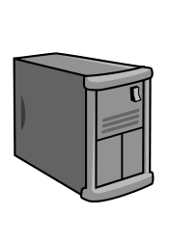
CSRF
Cross-site request forgery attack
Evil.com
<form action=“mysite.com/ChangePassword”>
MySite.com
Authentication cookie
Login
Submit data on behalf of User
User

Slide 24
Protect from CSRF
Check if the submitted form came from our server
[HttpPost]
[ValidateAntiForgeryToken]
[Authorize]
public ActionResult ChangePassword()
{
ChangePassword...
}
@using (Html.BeginForm("ChangePassword", "Account")) {
@Html.AntiForgeryToken()
@Html.ValidationSummary()
<li>
@Html.LabelFor(m => m.NewPassword)
@Html.PasswordFor(m => m.NewPassword)
</li>
}
Prevents forgery of a request
Generates a hidden field(anti-forgery token) that is validated on form submission

Slide 25
SQL Injection
Commands inserted into SQL where only data was expected
Entity framework helps to prevent SQL injection
Expected user input
Select * from users where username = ’Niki’
;Delete from Users where username = ‘Niki’;. . .
Added as addition to the input

Slide 26
Security useful links
http://haacked.com/archive/2009/06/25/json-hijacking.aspx
http://en.wikipedia.org/wiki/Cross-site_request_forgery

Slide 27
Simple Membership

Slide 28
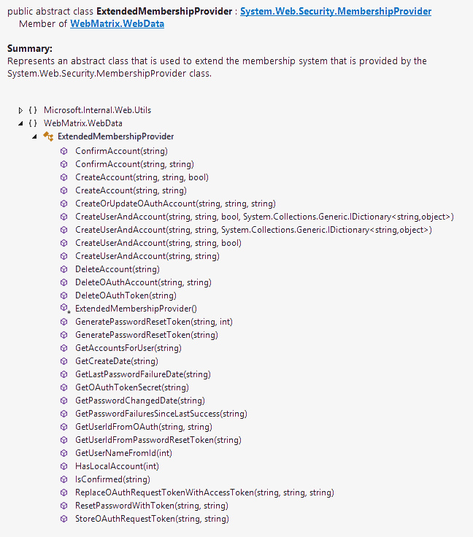
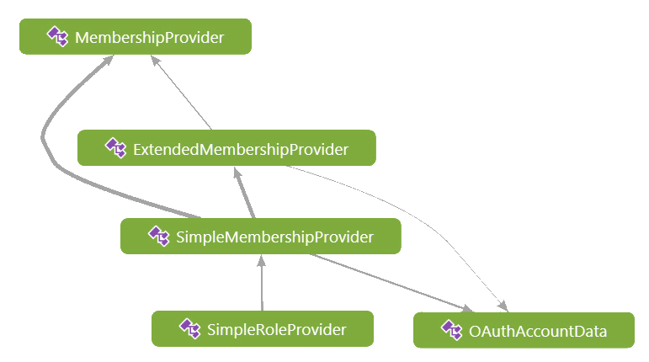
Membership system
Membership classes
Abstract class part of the System.Web.Security
Abstract class that inherits MembershipProvider and is part of WebMatrix.WebData
Implementation of the ExtendedMembership class

Slide 29
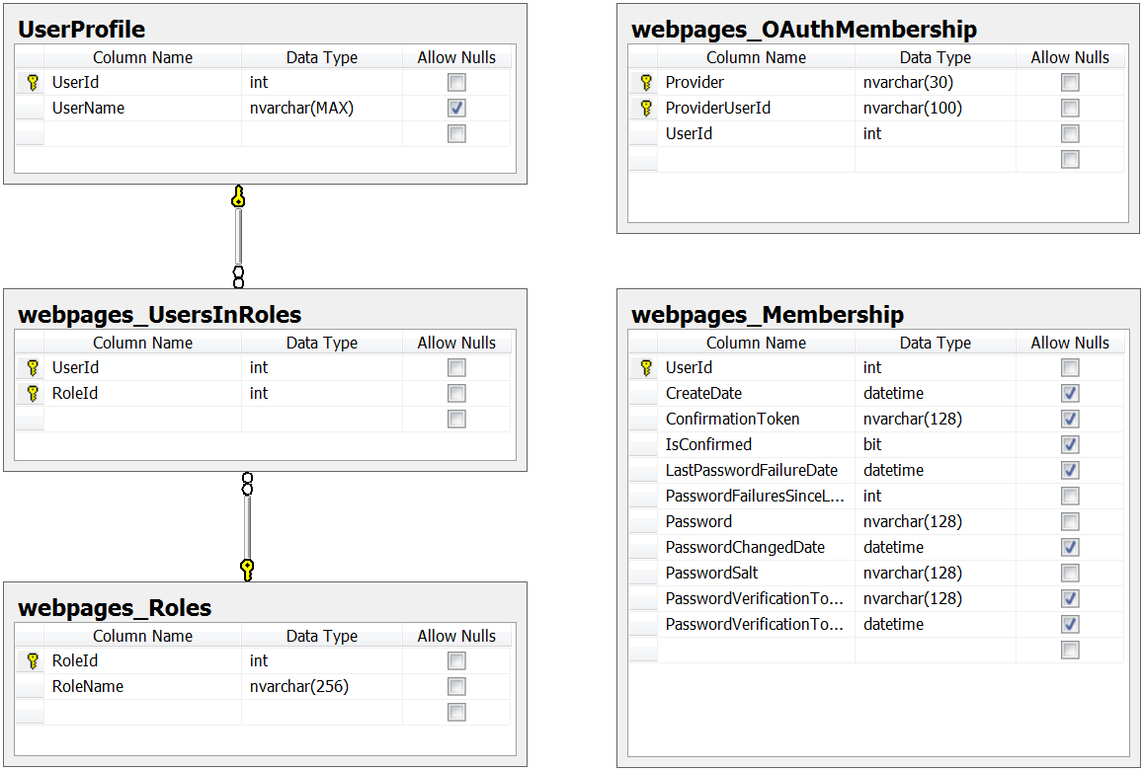
Simple membership schema
Works with existing schema
It’s easy to integrate it with existing Entity Model

Slide 30

Performance
Optimizing ASP.NET MVC application

Slide 31
Disable unused view engines
Disable unused view engines
Global.asax
ViewEngines.Engines.Clear();
ViewEngines.Engines.Add(new RazorViewEngine());
When accessing data via LINQ rely on IQueryable
Use caching

Slide 32

Bundles and Minification
Bundling – concatenating multiple files into a single download
Minification – making the download file as small as possible
Decrease page load times
System.Web.Optimization
WebGrease.dll and Antlr3.Runtime.dll
Measure time for getting all resources for a certain page with browser Dev. tools or Fiddler

Slide 33
Bundles
Introduced in ASP.NET MVC 4
Concatenating files into a single file – browsers supports limited concurrent requests ~ 6
Minifies files
Validating the code in the JavaScript files
Sprites any background images in CSS files
Manually through the console application:
[Full Path..]\WebGrease.1.3.0\tools>WG.exe -b -in:.\scripts -out:.\bscripts.js – Create a bundle

Slide 34
Bundles in ASP.NET MVC
Configure bundles
Add bundles to the global bundle table
Specify a global virtual path
Be careful with relative images paths
Include the files in the bundle.
Use wildcards (*) to avoid issues with file versions
Register bundle table during application startup
<compilation debug=“true” />
BundleTable.EnableOptimization = true;

Slide 35
Scripts and styles bundles
Adding bundles in the Bundle Table
bundles.Add(new ScriptBundle("~/bundle/jquery").Include(
"~/Scripts/jquery-{version}.js"));
"~/Scripts/jquery-1.*“
));
bundles.Add(new ScriptBundle("~/bundle/kendo").Include(
"~/Scripts/kendo/kendo.all.js", "~/Scripts/kendo/kendo.aspnetmvc.js", "~/Scripts/kendo/cultures/kendo.culture.bg.js", ));
bundles.Add(new StyleBundle("~/content/kendo").Include(
"~/Content/kendo/kendo.common.css",
"~/Content/kendo/kendo.metro.css",
"~/Content/kendo/kendo.black.prefixed.css",
"~/Content/kendo/kendo.default.prefixed.css“
));
BundleTable.EnableOptimization = true;
Bundle table
Use wildcards and {version}
Virtual path for the bundle
Virtual path for the bundle
Enable / Disable optimization

Slide 36
Rendering Bundles
Rendering bundles in ASP.NET MVC
@Scripts.Render(“~/bundle/jquery”);
@Scripts.Render(“~/bundle/kendo”)
<link href=“@Bundle.Bundles.ResolveBundleUrl(“bundle/kendo”)” rel=“stylesheet” type=“text/css” />
@Styles.Render(“/content/kendo”)
@Scripts.Render(“~/bundle/modernizr”)
<script src="/bundles/modernizr?v=jmdBhqkI3eMaPZJduAyIYBj 7MpXrGd2ZqmHAOSNeYcg1">
</script>
Lives inside System.Web.Optimization so we need to include it in web.config
Magic string value helps to check changes in the bundle to avoid chaching
http://channel9.msdn.com/Series/mvcConf/mvcConf-2-Steven-Smith-Improving-ASPNET-MVC-Application-Performance

Slide 37
Demo: Measuring Perfomance
Web Performance Tests and Load Tests

Slide 38

Caching

Slide 39
Output cache
OutputCache action filter
Use as attribute on action or controller
Specify Duration and VaryByParam
Configurable with cache profiles in web.config
Don’t use OutputCache on views in APS.NET MVC
Public class CachedController : Controller
{
[OutputCache(Duration=60, VaryByParam=“none”)]
public ActionResult Index()
{
Return View();
}
}

Slide 40
OutputCache properties
Attribute | Description
CacheProfile | Associates a response with a group of output-caching settings specified in the web.config file.
Duration | The time, in seconds, that the response is cached.
Location | Specifies the location (browser, proxy, or server) to store the response of the method call. The attribute takes its value from the OutputCacheLocation enumeration.
NoStore | Indicates whether to send a Cache-Control:no-store header to prevent browser-side storage of the response.
SqlDependency | Indicates a dependency on the specified table on a given Microsoft SQL Server database. Whenever the contents of the table changes, the response is removed from the cache.

Slide 41
OutputCache properties (2)
Attribute | Description
VaryByContentEncoding | Content encoding by which you intend to differentiate cached responses.
VaryByCustom | A semicolon-separated list of strings that lets you maintain distinct cached copies of the response based on the browser type or user-defined strings.
VaryByHeader | A semicolon-separated list of HTTP headers.
VaryByParam | A semicolon-separated list of strings representing query string values sent with GET method attributes, or parameters sent using the POST method.
OutputCache action filter

Slide 42
Localization and Resources

Slide 43
Localization and Culture
Thread.CurrentCulture property
Example: DateTime.Now.ToString()
Thread.CurrentUICulture impacts resource load
Accept-language header
<system.web>
<globalization culture=“auto” uiCulture=“auto” />
. . .
</system.web>

Slide 44
Resources
*.resx files that store localized text
Strings.resx stores default resources
Strings.bg.resx stores resource for Bulgaria
Resource manager loads appropriate file
Build action - embedded resources
Resources could be used in views, models, controllers, data annotations
Access modifier should be public

Slide 45
Diagnostics and Health Monitoring
Health Monitoring, Elmah and log4net

Slide 46
Diagnostic and Monitoring
When application started and shutdown
Unhandled exceptions – stack traces
Security related diagnostics
Malicious user tries to access unauthorized area
When a user logged in
Tracing is a great feature for monitoring ASP.NET Web Forms projects (Lifecycles events)
Errors can be send on email, log in a file or save in a database

Slide 47
Health Monitoring
The built in system in ASP.NET for creating, monitoring and publishing diagnostic info
The settings for this monitoring system are set in the machine level web.config file C:\Windows\Microsoft.NET\Framework\{.NET version}\Config\web.config
<eventMappings>- Map specific types of errors to an event
<rules>Routed events to a provider
<providers>Set where to store diagnostic info

Slide 48
Elmah
Exceptions logging modules and handlers
Install through NuGet – Elmah.MVC
It defines some basic settings in web.config
Register global filter in the FilterConfig class
filters.Add(new HandleErrorWithElmahAttribute());

Slide 49
Elmah configuration
Configure Elmah in the web.config
<elmah>
<security allowRemoteAccess="true" />
<errorLog type="Elmah.XmlFileErrorLog, Elmah" logPath="~/App_Data/Elmah" />
</elmah>
<location path="elmah.axd">
<system.web>
<authorization>
<allow roles="Administrator" />
<deny users="*" />
</authorization>
</system.web>
</location>
http://code.google.com/p/elmah

Slide 50
Unit testing and TDD

Slide 51
TDD
Test Driven Development is:
Software executable specification
Interactive design
Like using a white board with real code
Removing the fear of changing something
Test Driven Development is not:
Just writing unit test
100 % code coverage
A replacement for QA and integration tests

Slide 52
Unit testing
What to test
Did the controller return the proper ActionResult?
Did the controller build the proper model?
Did the controller produce the right side-effects?

Slide 53
Unit testing
Check if conventional view is rendered up on executing an action in a specific controller.
[TestClass]
Public class IsMovieControllerIndexActionExecutes
{
[TestMethod]
public void IsItRendersTheView
{
var controller = new MovieController();
var result = controller.Index();
Assert.AreEqual(“”, result.ViewName);
}
}
Arranging something
Asserting some characterics of the performed action
Performing some action

Slide 54
Deployment and Configuration

Slide 55

Configuration files
XML files
Authentication and Authorization
Compilation
Connections
Custom errors
Page settings
Trace and Debug settings
Hierarchy of the configuration files
Extensibility of the configuration files

Slide 56
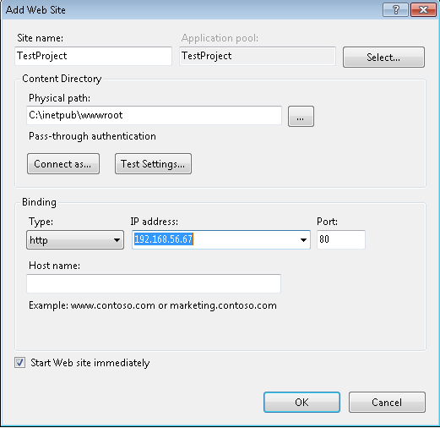
Deployment in IIS
Install IIS through “Turn windows on/off” in Control panel
Add site in the IIS configuration manager
Set site name
Physical path(inetpub)
Add local IP and port
Check .NET version in the application pool

Slide 57
Deploy the application
Open the publish window, right click on project
Different publish methods
Web deploy
Build deployment package and add it manually
Configure service URL – IP address of the server
Site/Application name as it was added in the IIS
Credentials and destination URL
Different types of deploy configurations – release, debug, deploy. Different web.config

Slide 58
ASP.NET MVC Good Practices

Slide 59
Good Practices
Use ViewModels and Model Validation
Remove unused ViewEngines
Add namespaces to Views
Speed things up with output caching
Explore the ASP.NET MVC source code
http://aspnetwebstack.codeplex.com/
Use strongly typed views
Avoid the ViewBag

Slide 60
Isolate your layers properly
ViewModel for transmitting data to the view
simple POCO de-normalized objects
Use Controllers for selecting the view to be shown and not for business logic
Use the view for displaying Html which will be rendered by the browser
Not for business logic!
Use Services/Repositories for manipulating business objects

Slide 61
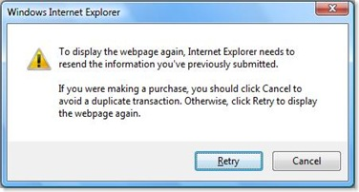
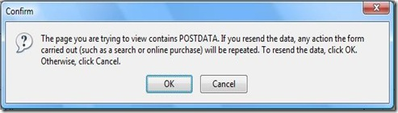
Use the PRG (PostRedirectGet)
Prevent reposts to the form
Issues an HTTP302 with temporary redirect
Use proper verbs [HttpPost], [HttpGet] on you controllers
Saving Temporary Data Across Redirects – TempData Dictionary

Slide 62
Productivity Tips
Use "NuGet" packages that help with productivity
RouteDebugger
ELMAH
MvcScafolding
JustCode (ReSharper)

Slide 63
Other tips
You can extend using HttpModules, HttpHandlers
You can use HttpCaching
HTML5 support
Easier deployment + minification (Including cloud deployment)
Asynchronous / Await
Tooling (Page Inspector)
Web Sockets

Slide 64
Think about globalization
Make you application support globalisation if its going to be on the internet
Don’t forget to make accessibility
http://plugins.jquery.com/project/KeyTips
Mobile phone support improvements

Slide 65
Summary
Model–view–controller (MVC) is a software architecture pattern that runs on top of ASP.NET
It has great separation of concerns and the code is testable, reusable and very extensible
It produces clean HTML5 and SEO URLs
Supports code first and database migrations
Services Web API

Slide 66
ASP.NET MVC Advanced Topics
http://academy.telerik.com

Slide 67



Free Trainings @ Telerik Academy
“C# Programming @ Telerik Academy
csharpfundamentals.telerik.com
Telerik Software Academy
academy.telerik.com
Telerik Academy @ Facebook
facebook.com/TelerikAcademy
Telerik Software Academy Forums
forums.academy.telerik.com

